Slide 1
Traffic Data Analysis
Road transport is essential for development as it provides mobility to people and goods. However, it also exposes people to the risk of road accidents, injuries and fatalities. Exposure to adverse traffic environment is high in India because of the unprecedented rate of motorization and growing urbanization fuel by high rate of economic growth. As a result, incidents of road accidents, traffic injuries and fatalities have remained unacceptably high in the India.

Slide 2

APACHE HIVE
HADOOP Tool to specially used to analyze large data sets easily with the help of few queries.
Apache Hive is a data warehouse software project built on top of Apache Hadoop for providing data query and analysis.
Hive gives an SQL-like interface to query data stored in various databases and file systems that integrate with Hadoop

Slide 3
REQUIREMENTS
USE OF TABLEAU
Tableau is a powerful and fastest growing data visualization tool used in the Business Intelligence Industry. It helps in simplifying raw data into the very easily understandable format.
Data analysis is very fast with Tableau and the visualizations created are in the form of dashboards and worksheets. The data that is created using Tableau can be understood by professional at any level in an organization. It even allows a non-technical user to create a customized dashboard.
The best feature Tableau are:
Data Blending
Real time analysis
Collaboration of data
Convert analysed dataset into interactive visualization.
Makes understanding better by comparison

Slide 4
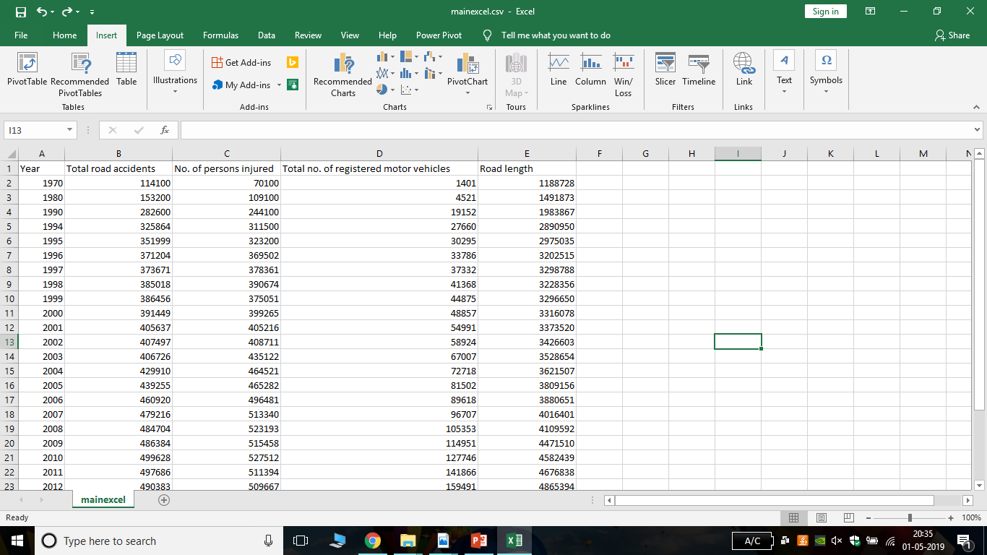
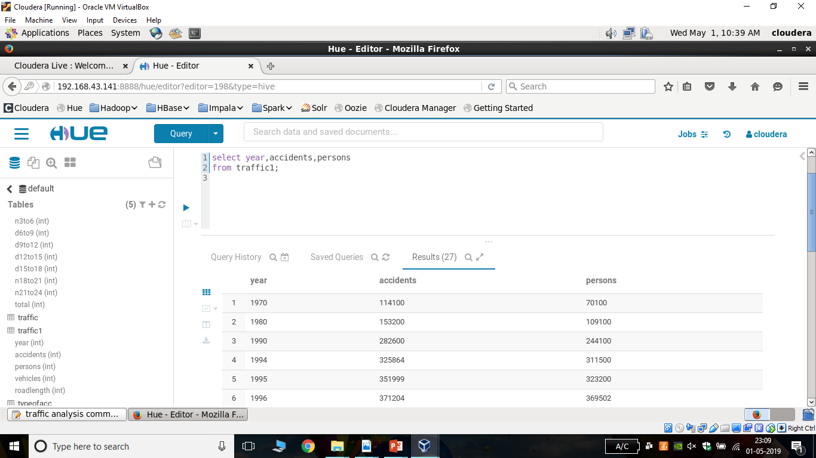
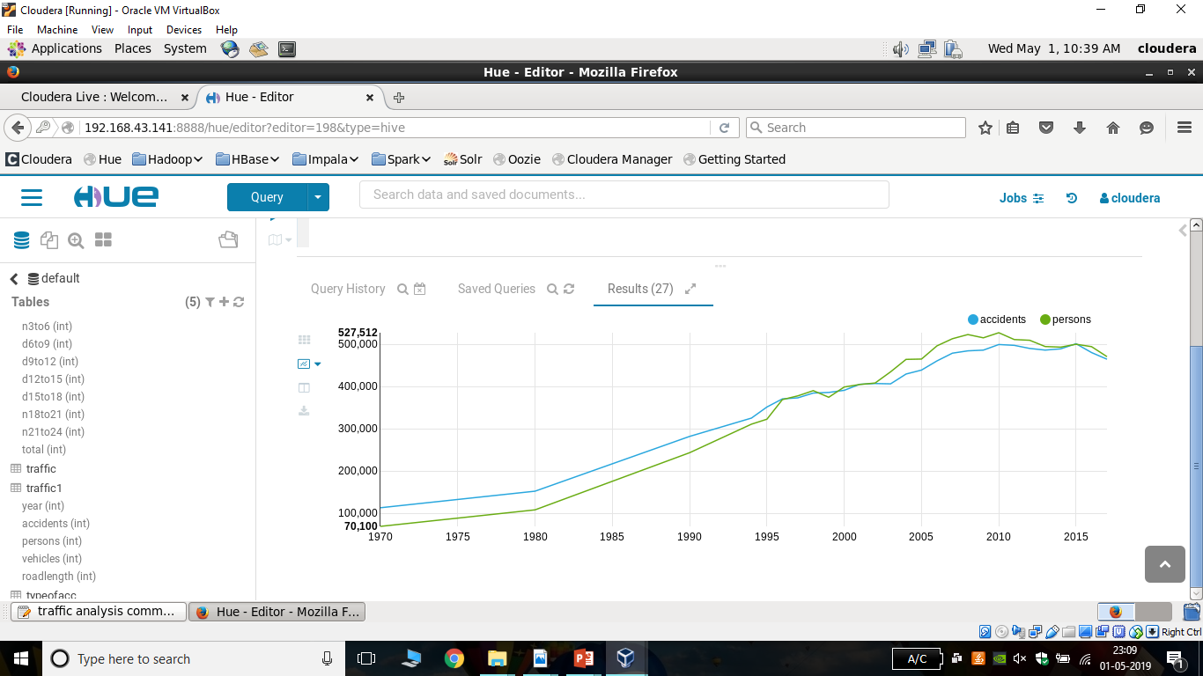
India Accident Data from 1970-2017

Slide 5

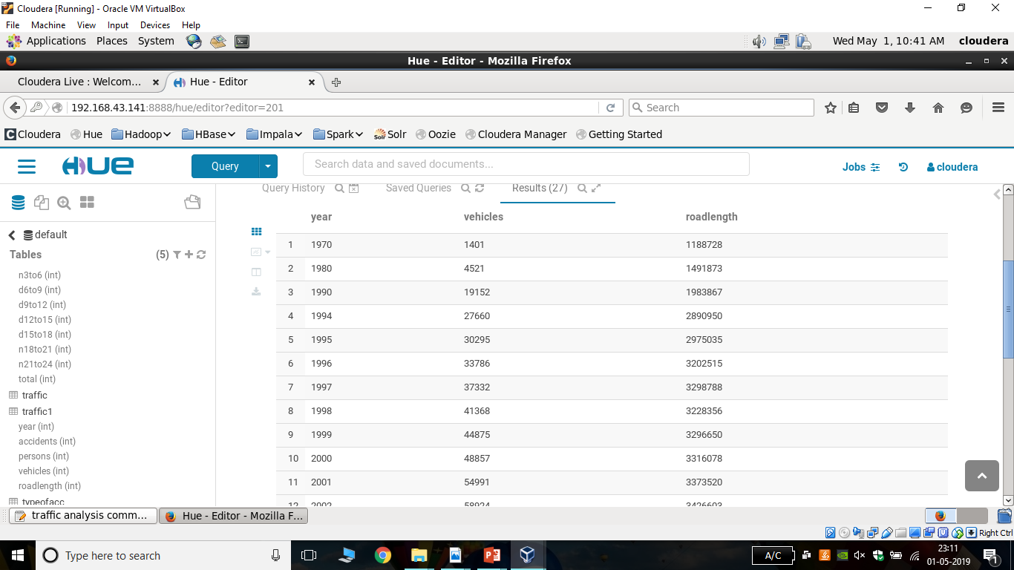
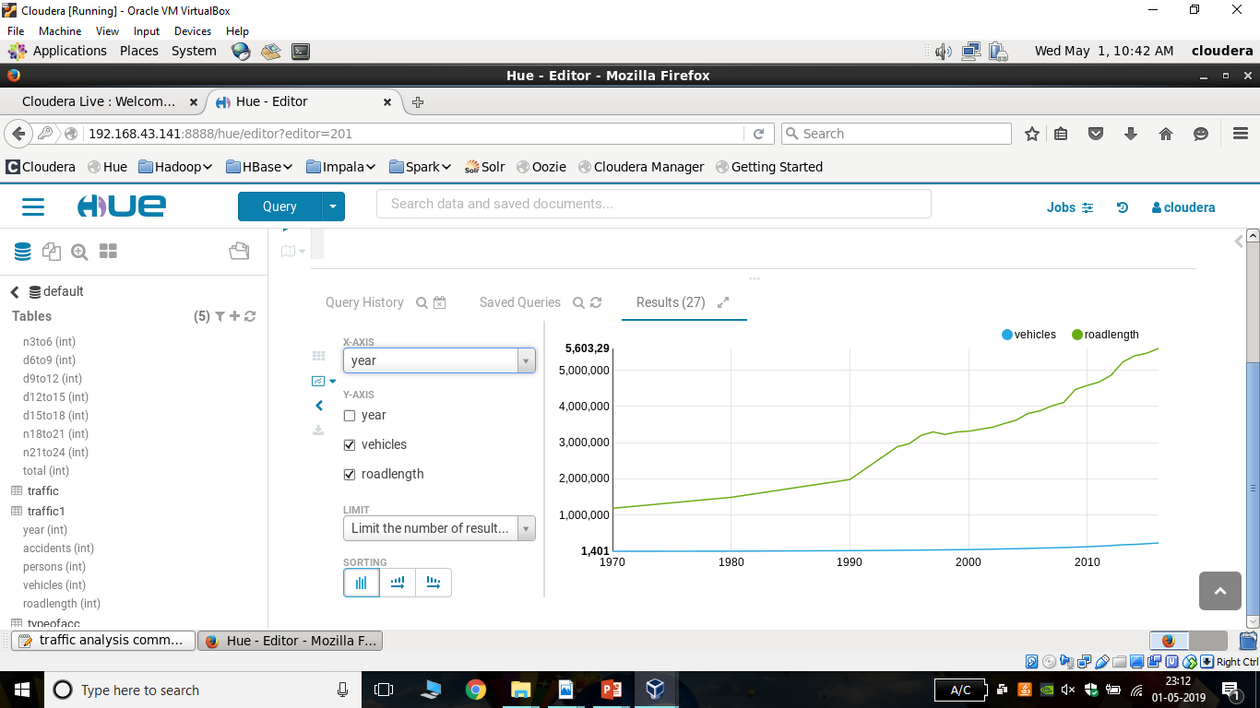

Slide 6
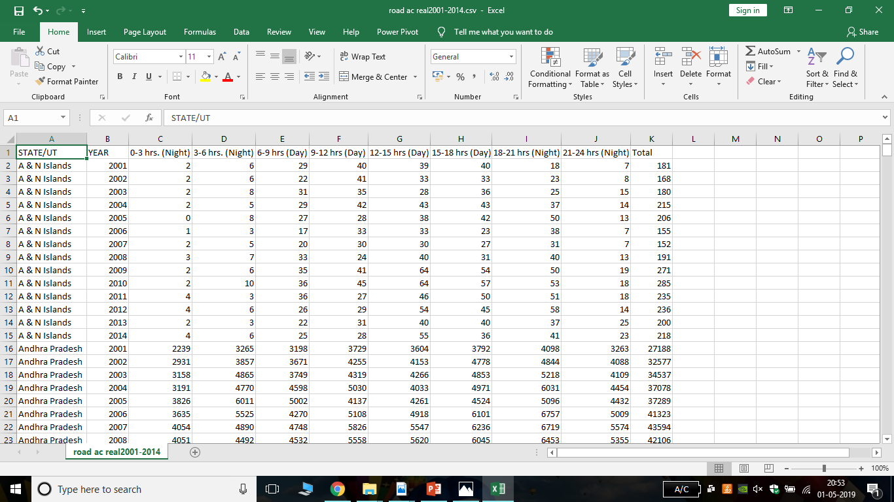
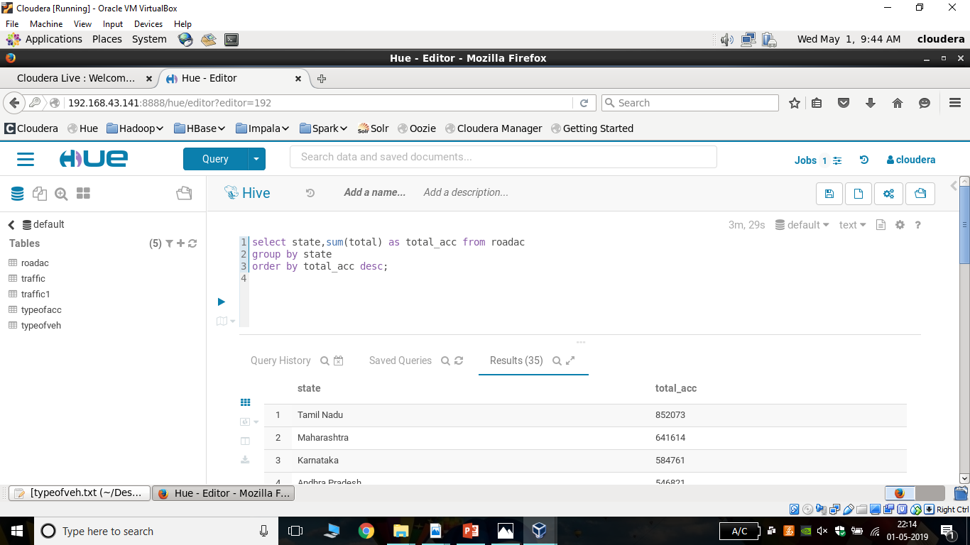
Time Occurrence Accident Dataset of all the states and union territories of India

Slide 7

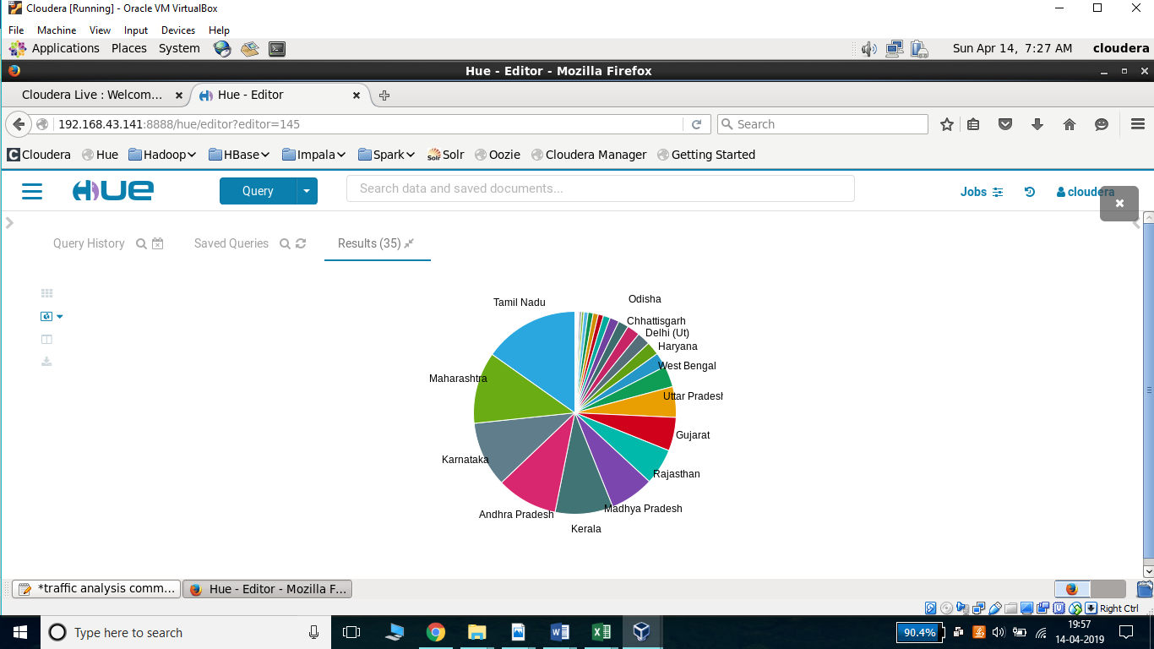

Slide 8
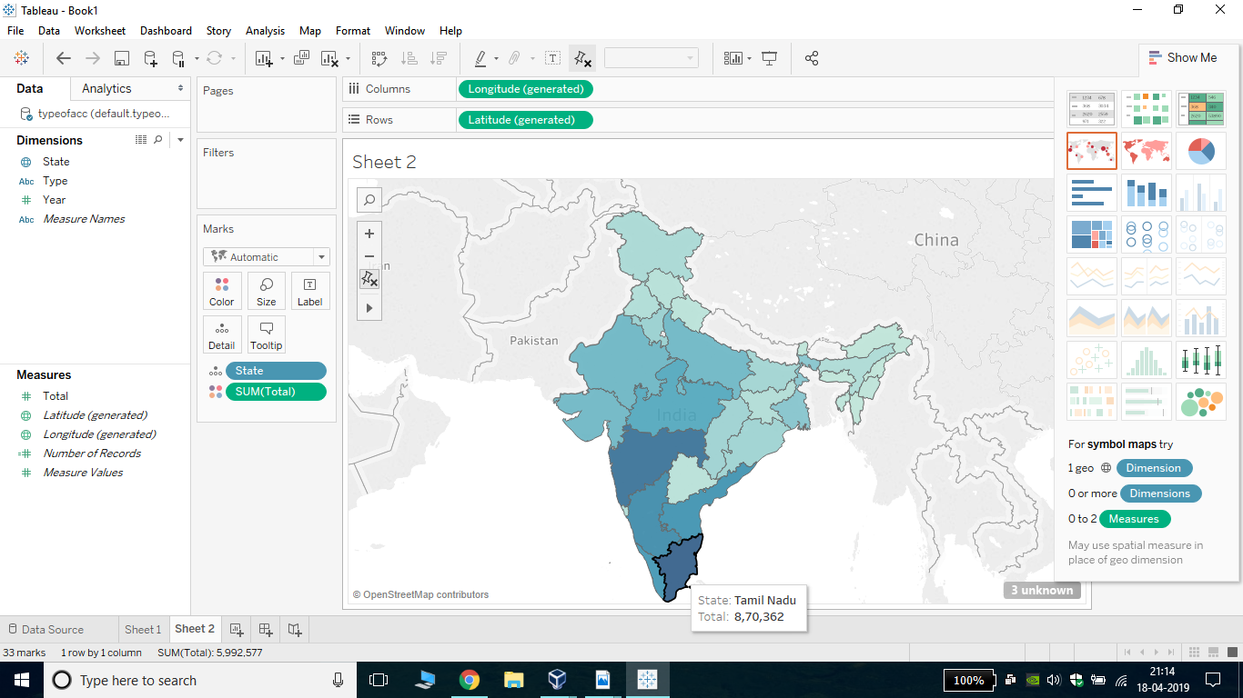
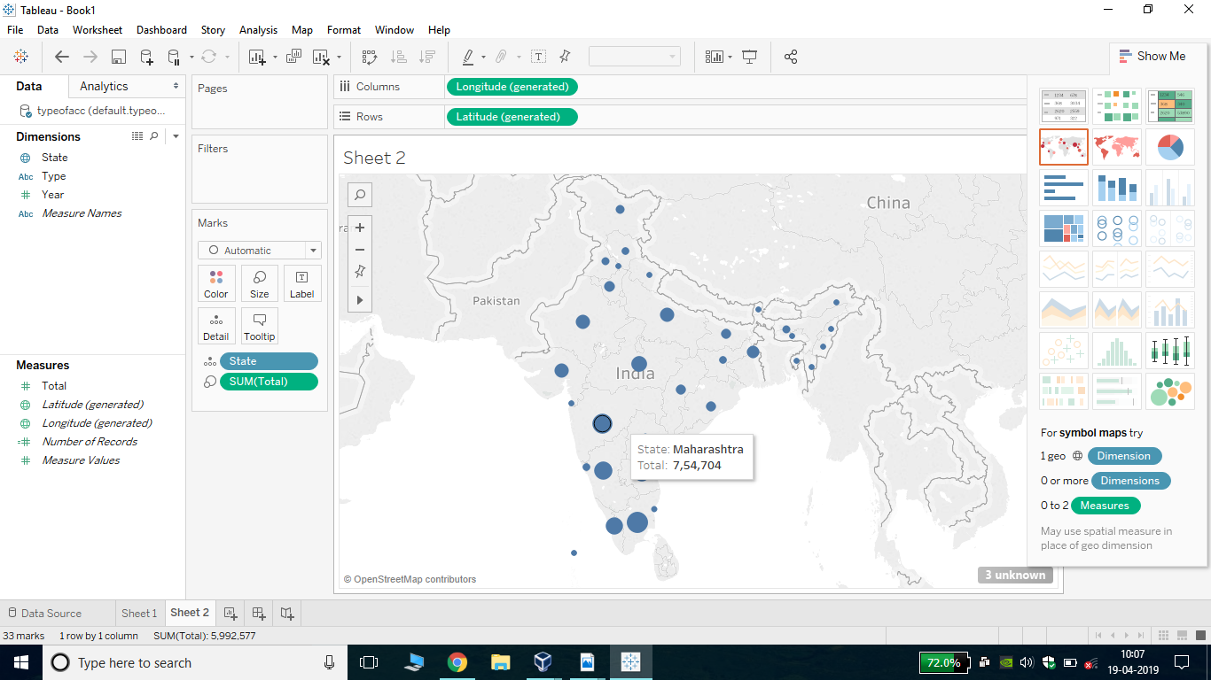

Slide 9
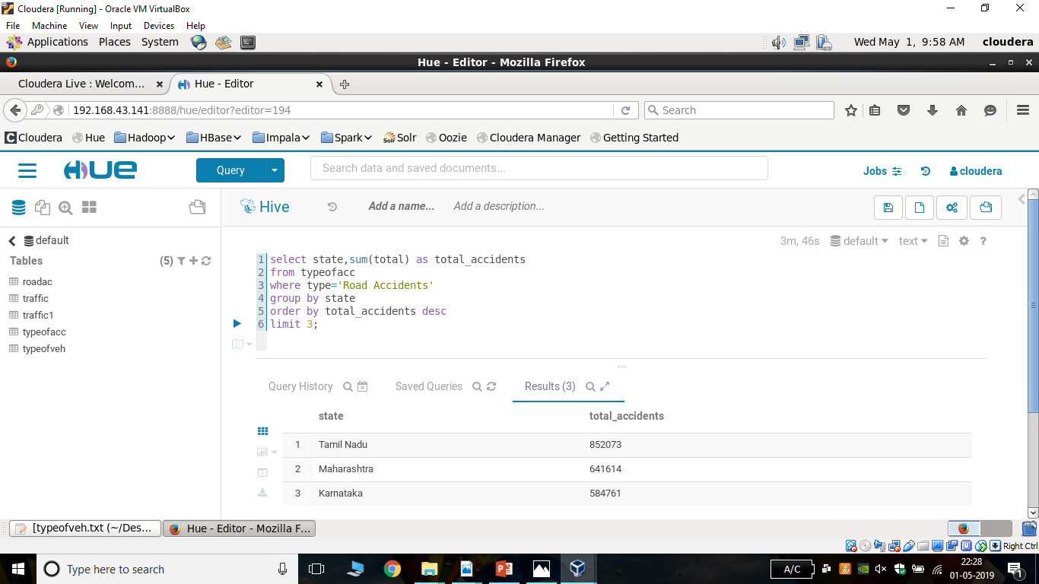
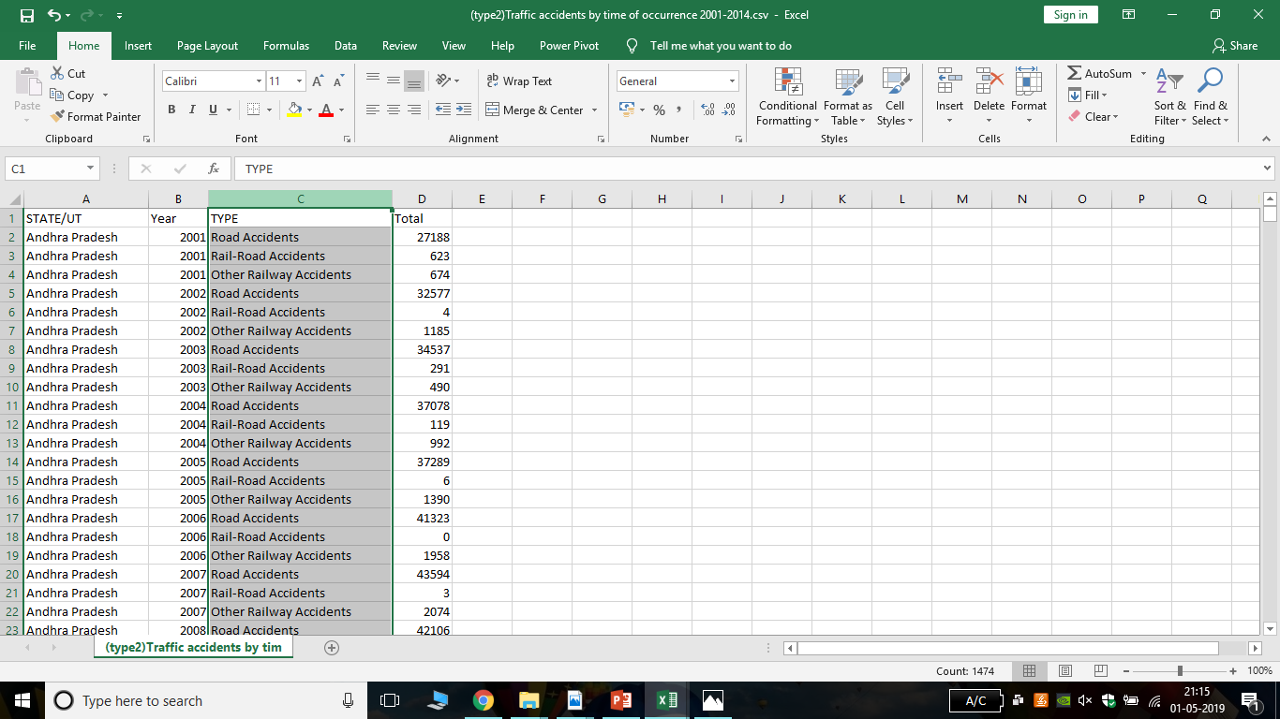
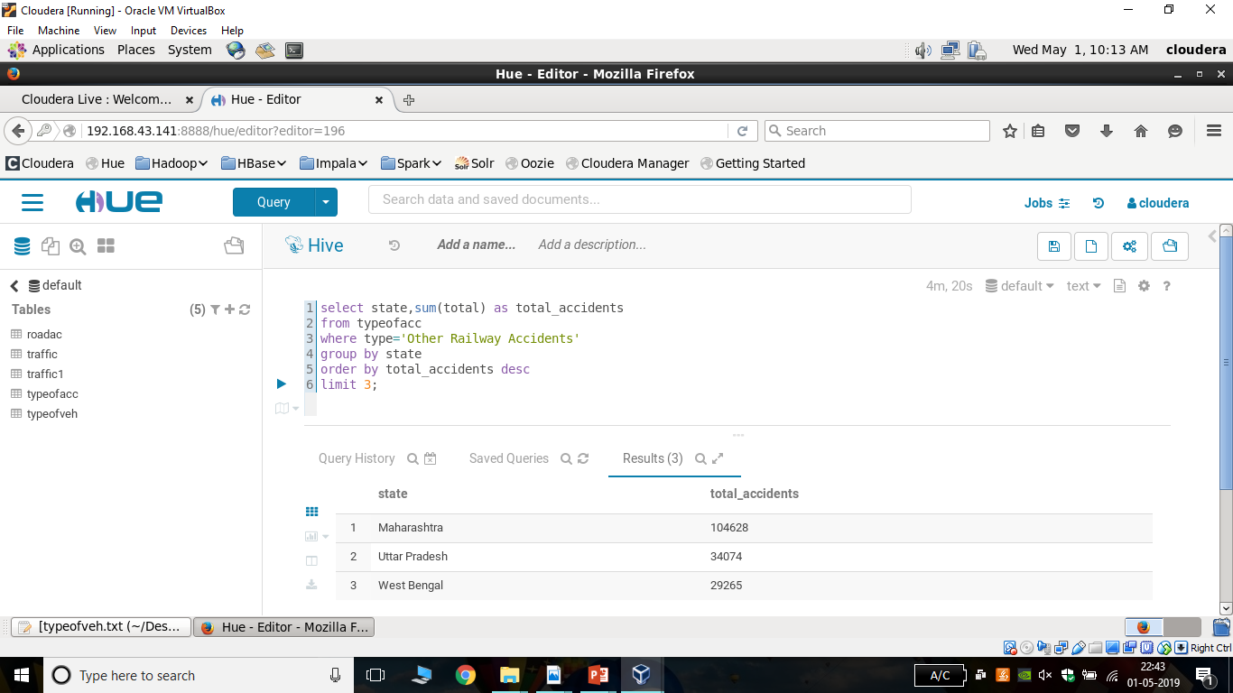
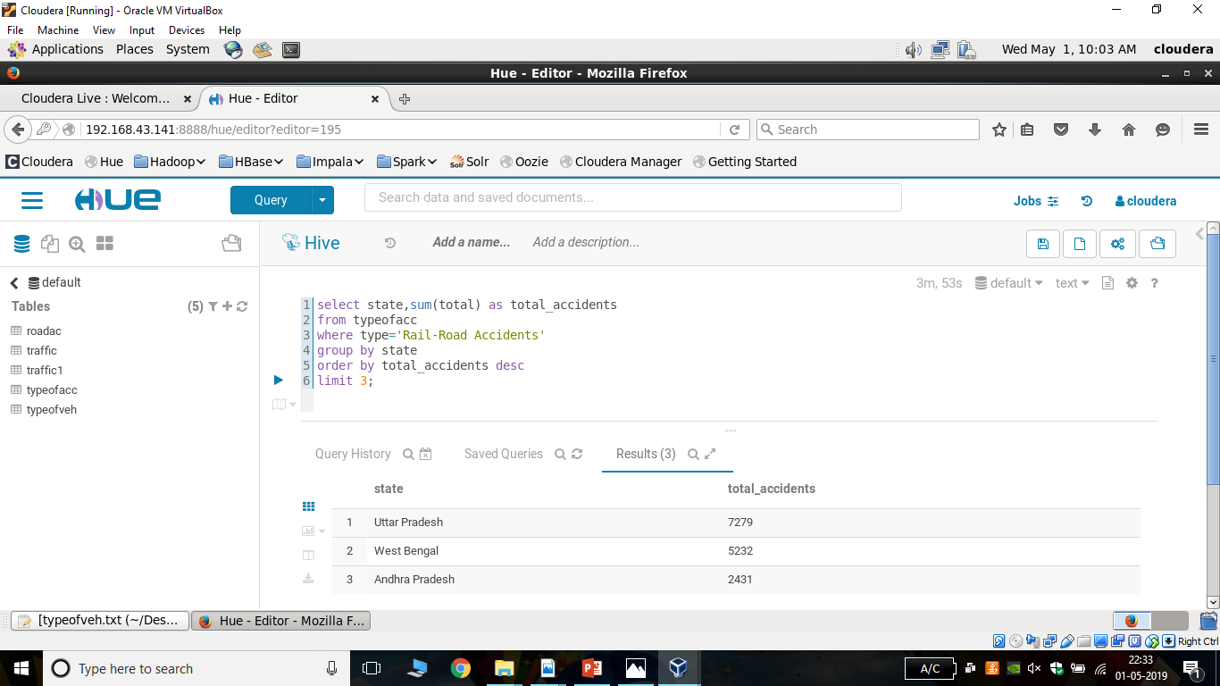

Slide 10
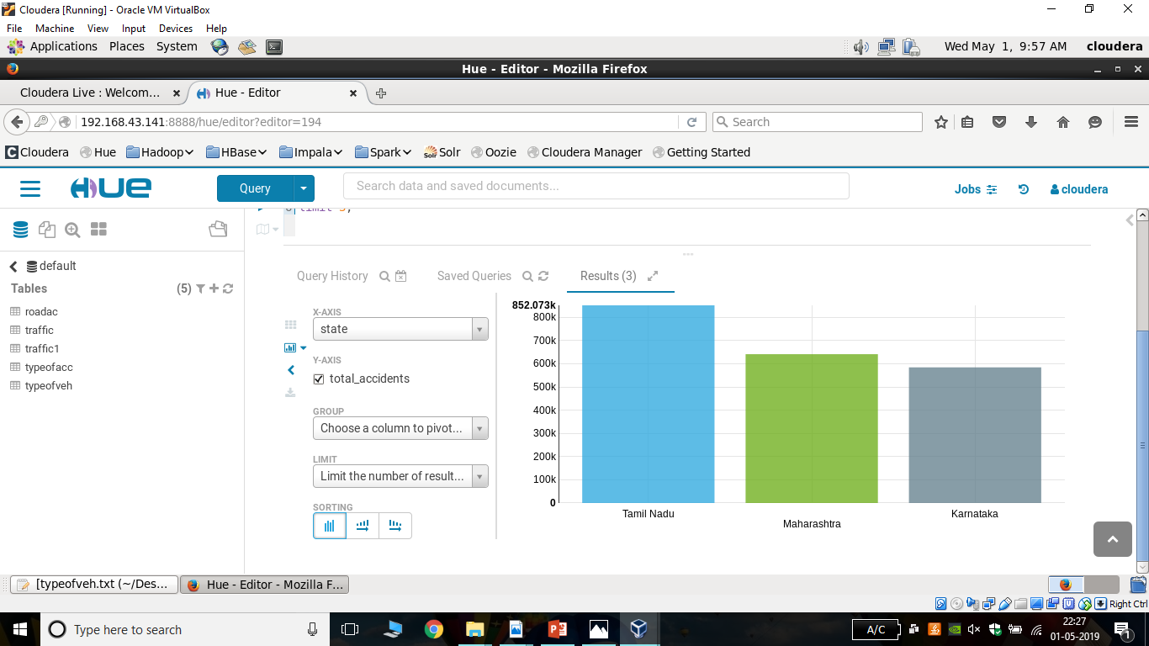
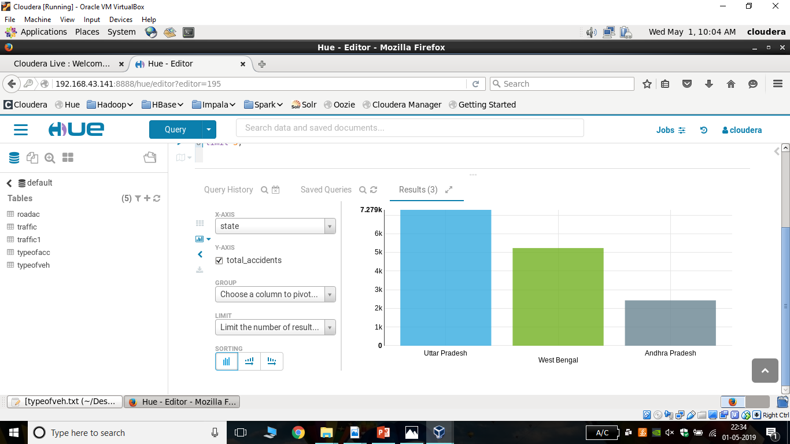
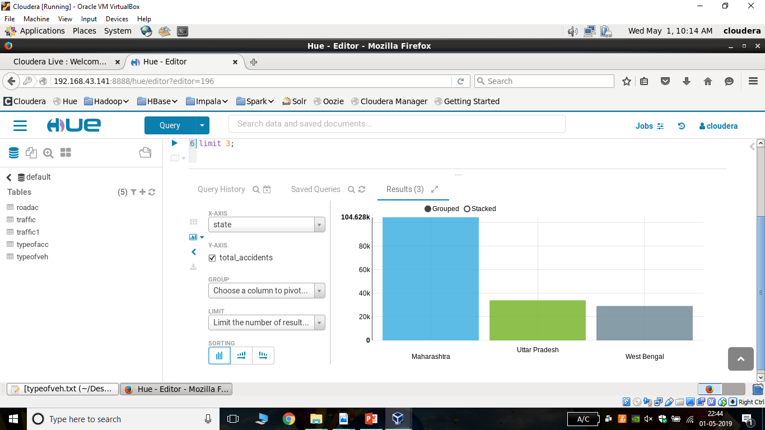
Top 3 States in types of Road Accidents in India
Road-Accidents
Rail-Road Accidents
Other Railway Accidents

Slide 11
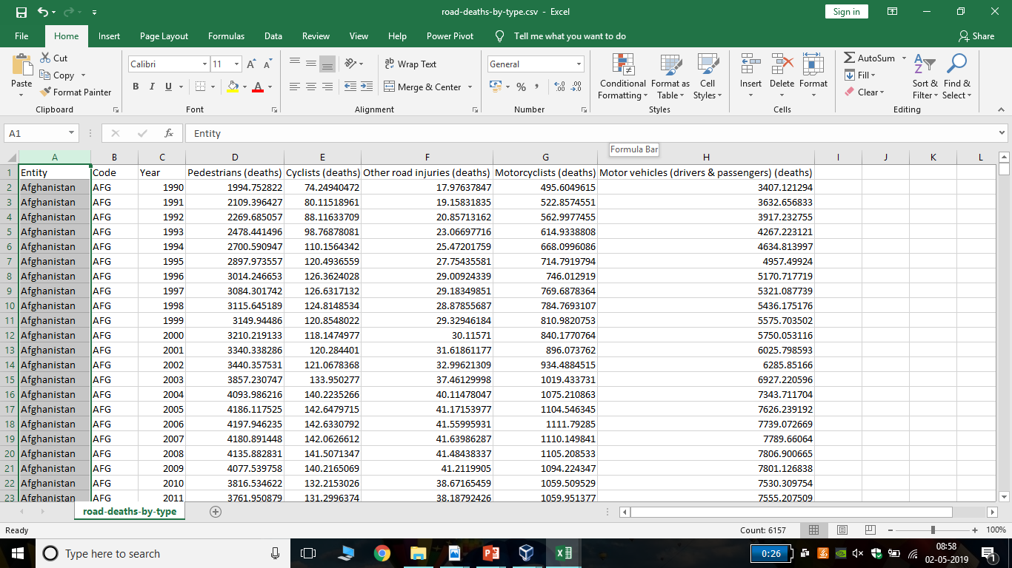
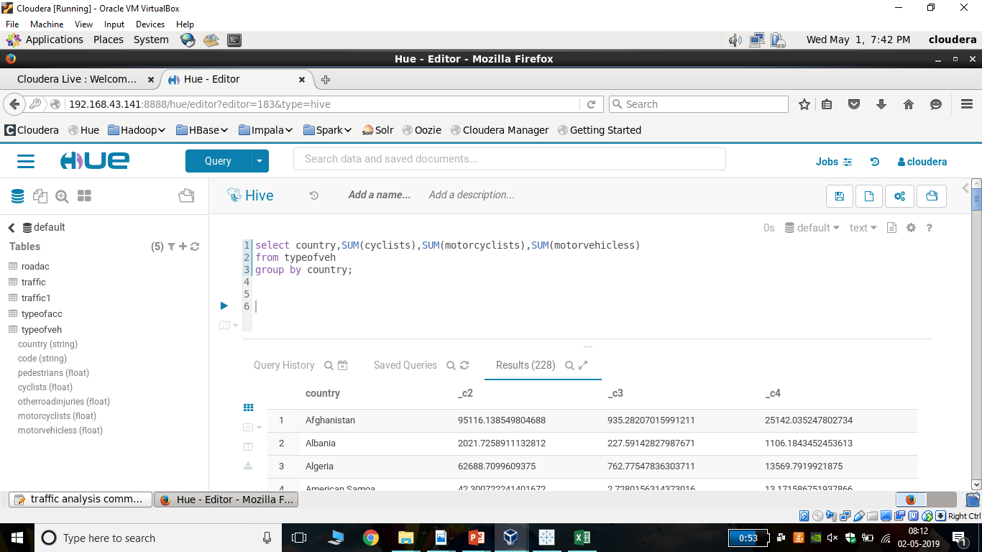
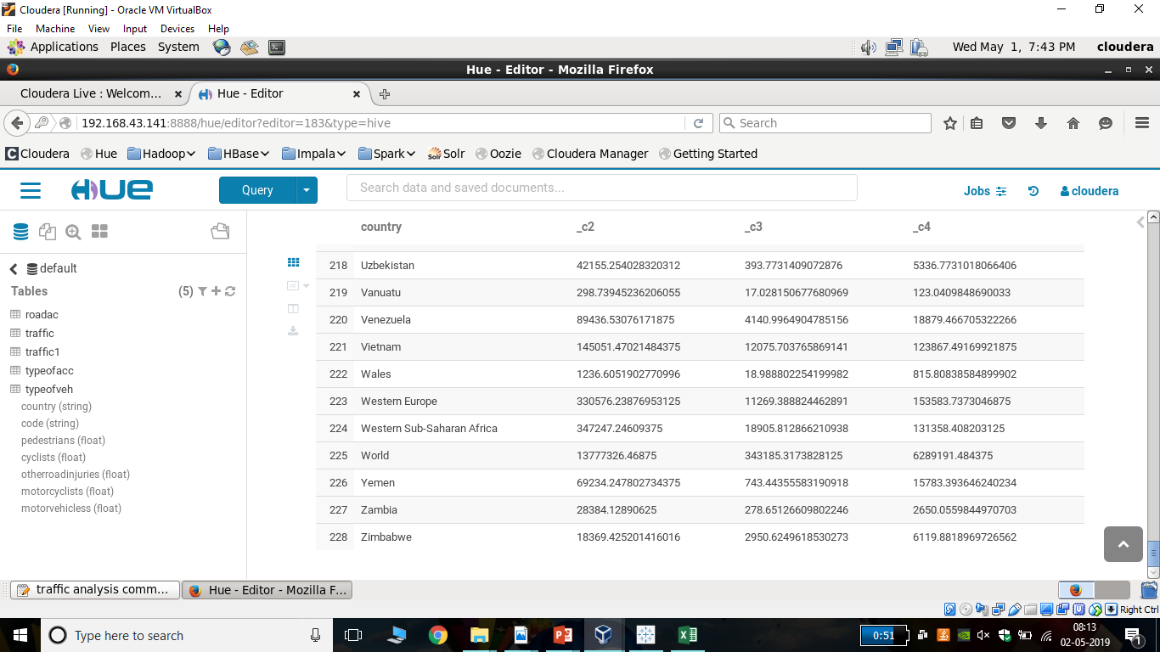
Dataset of all counties around the world including the accidents deaths by the type of vehicle

Slide 12
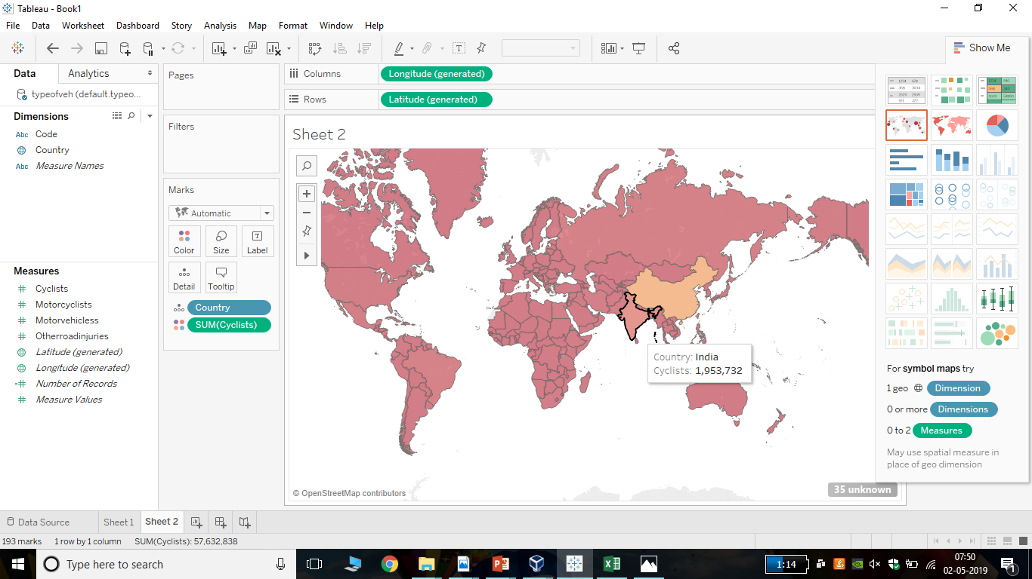
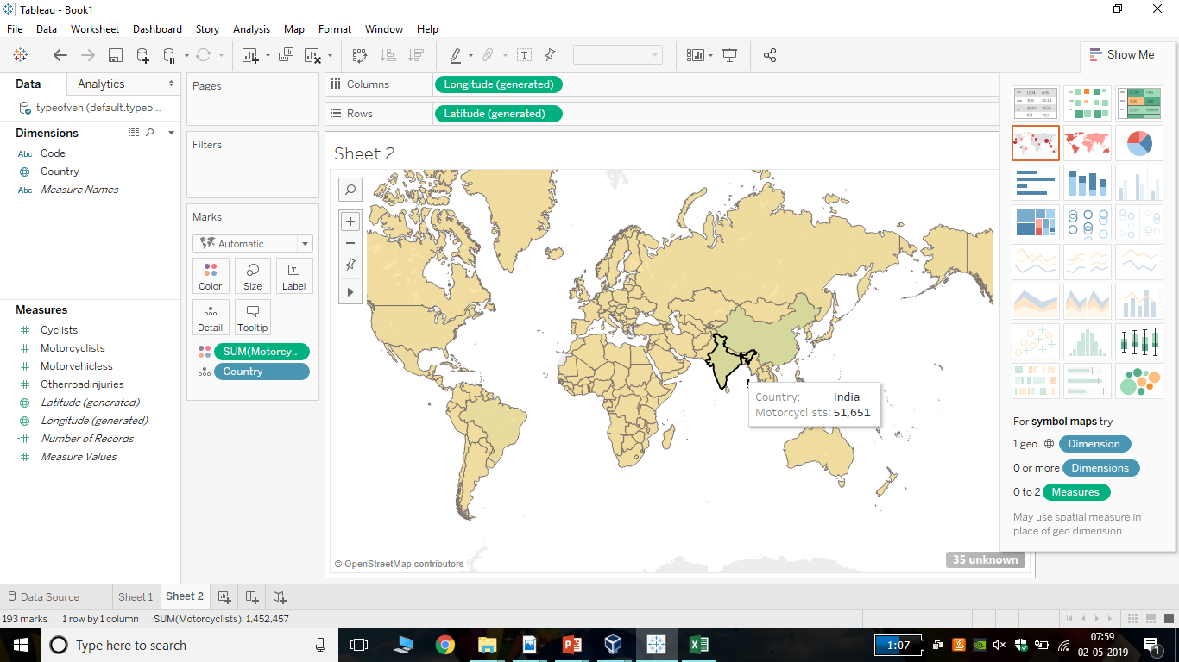
Cyclists Accident Analysis
MotorCyclists Accident Analysis

Slide 13
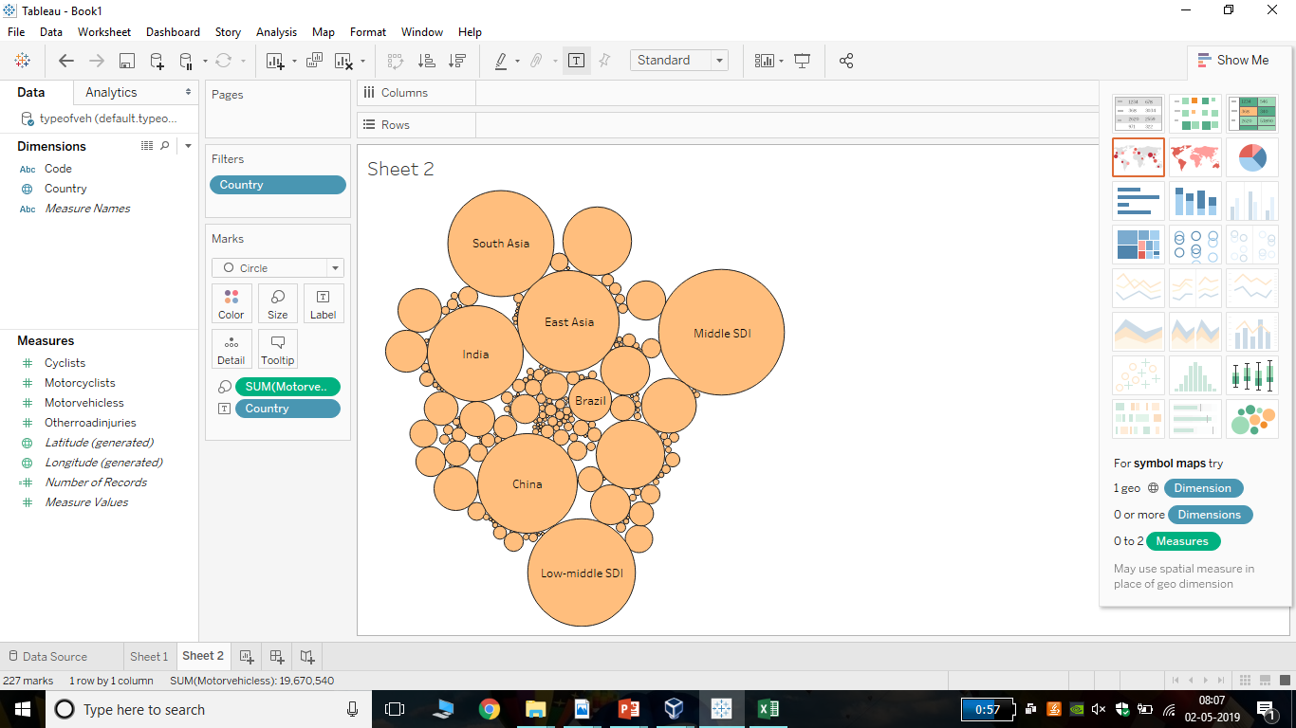
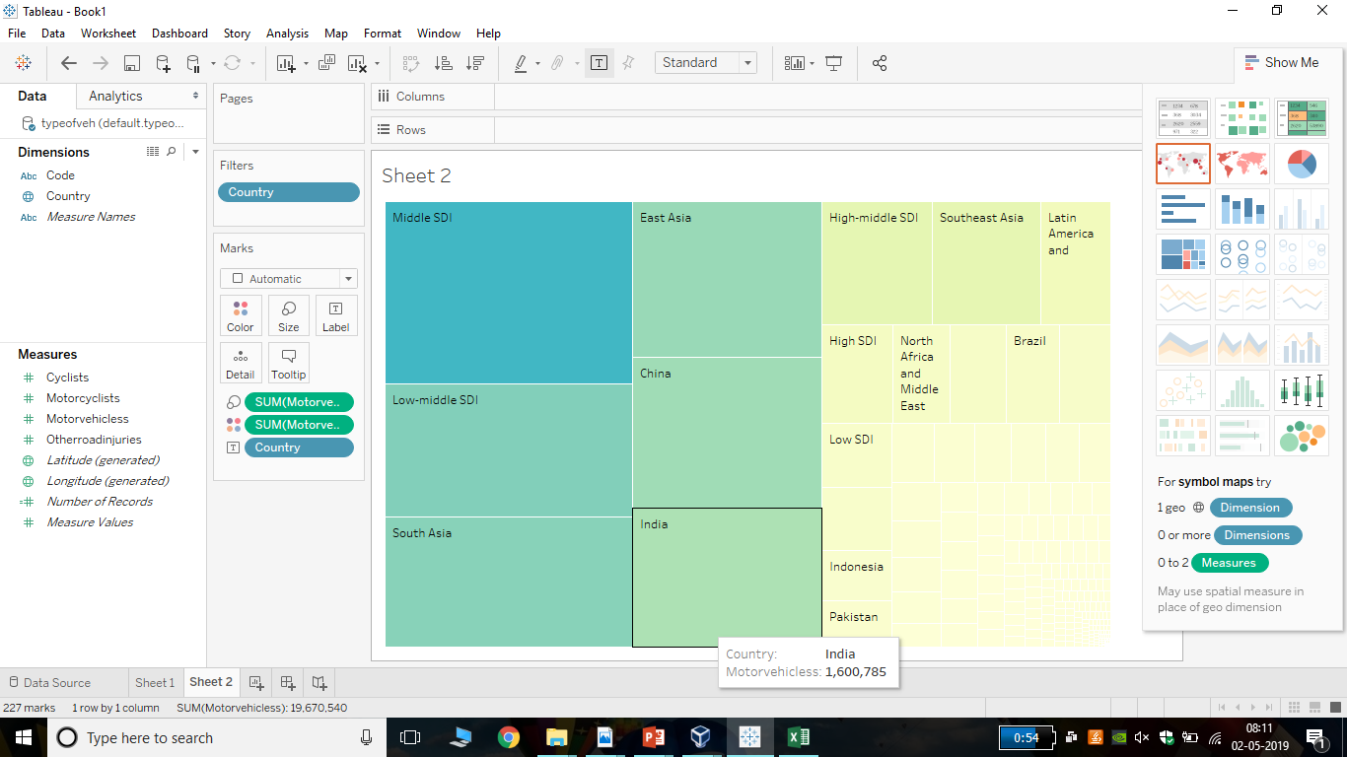

Slide 14
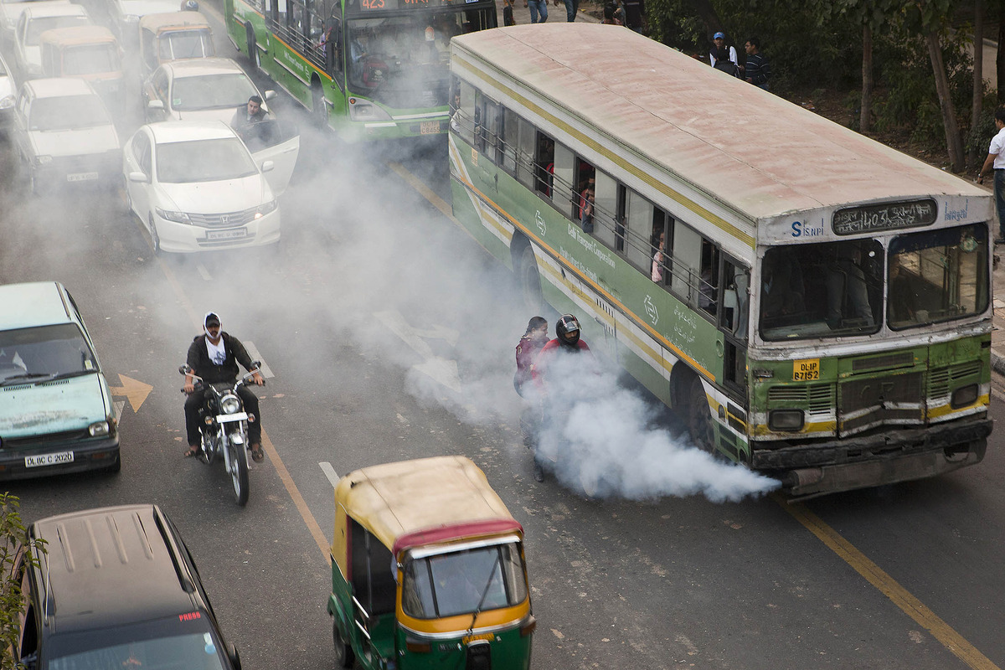
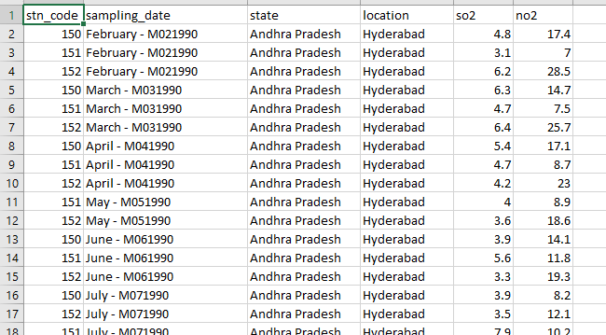
USE CASE OF HIVE- ANALYZING POLLUTION DUE TO TRAFFIC
In many areas, vehicle emissions have become the dominant source of air pollutants, including (NO2 and SO2).
Analyse amount of pollution due to vehicle emissions.
Includes analysis on large sets of data – estimation of pollution in every state of India.
DATA SET

Slide 15
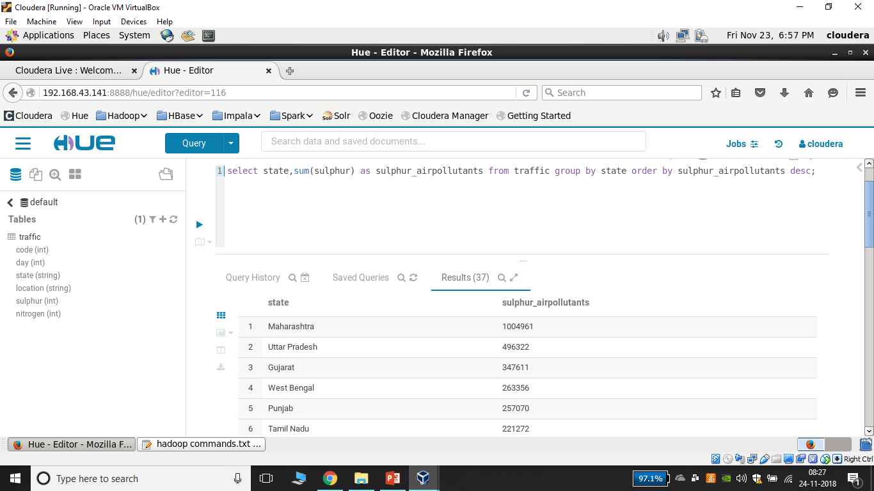
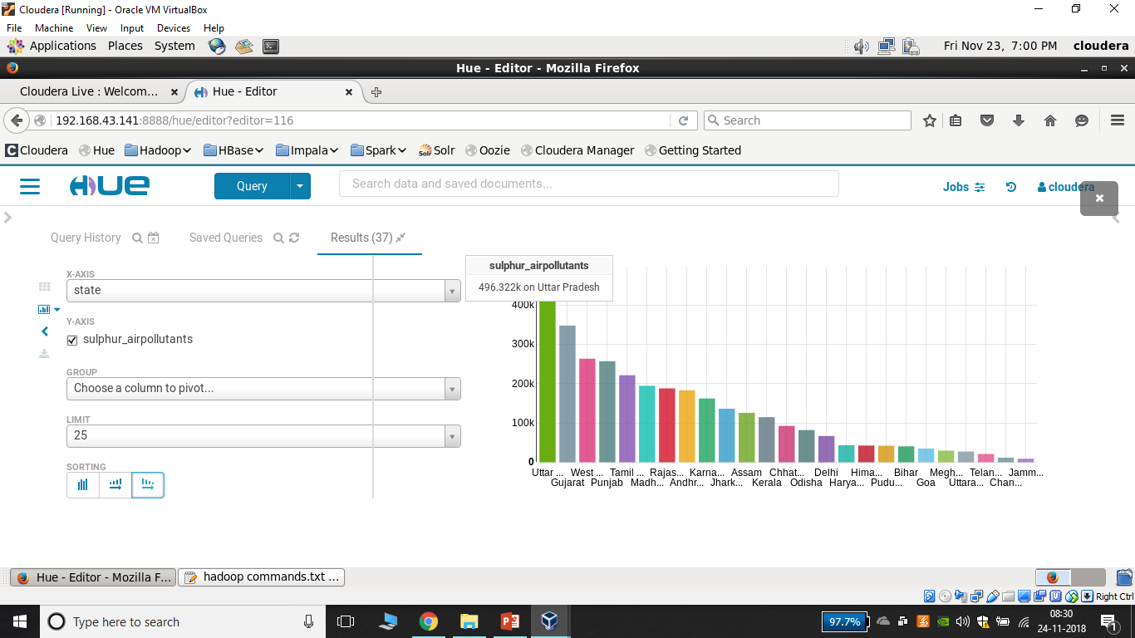
HIVE QUERY AND RESULT
DATA ANALYSIS

Slide 16
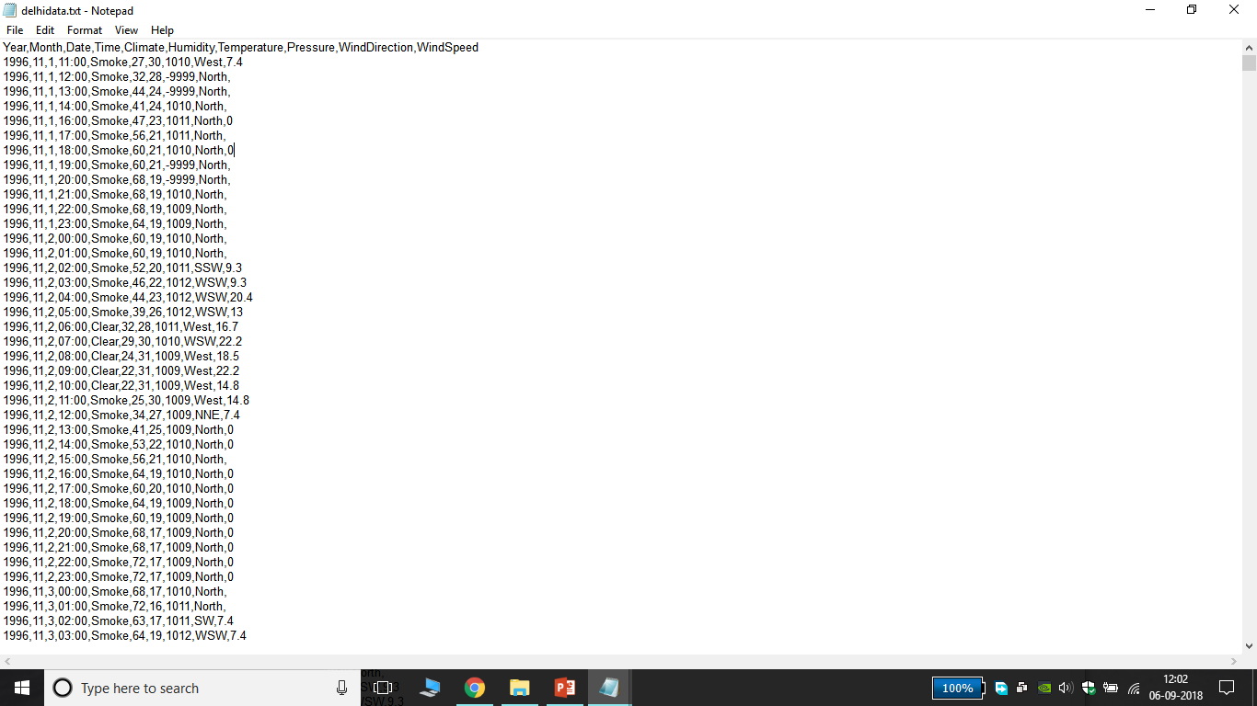
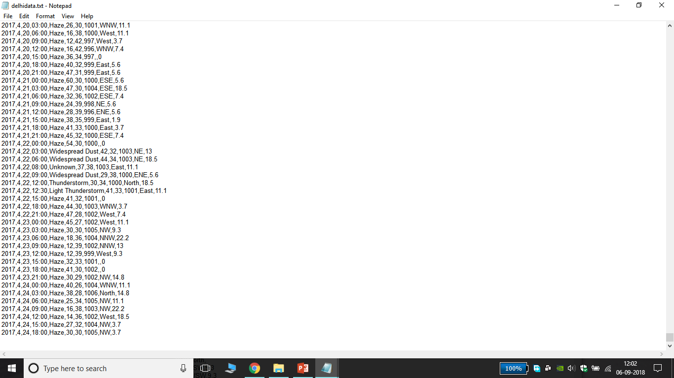
DELHI WEATHER DATA (1996 -2017)
YEAR
MONTH
DATE
TIME (min : sec)
CLIMATE
HUMIDITY
TEMPERATURE (Celsius)
PRESSURE (mm)
WIND DIRECTION
WIND SPEED (kph)

Slide 17
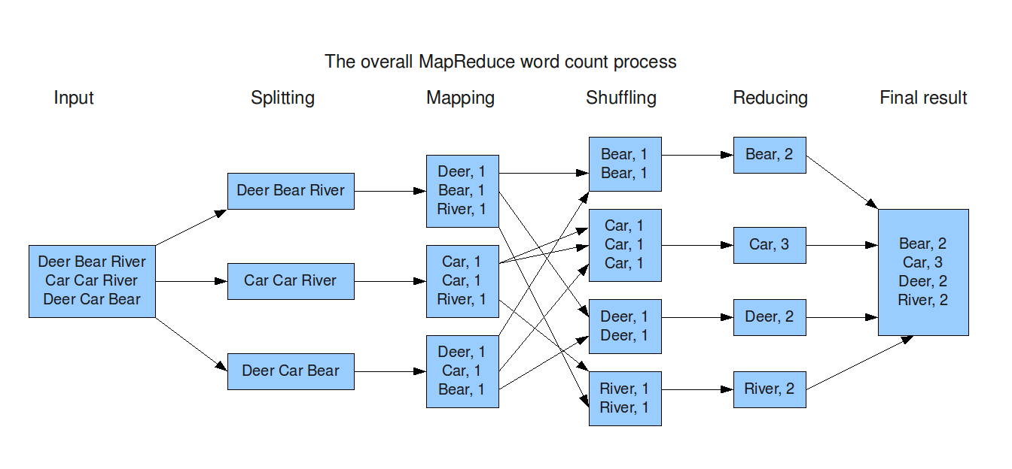
MAP REDUCING
MapReduce is the processing layer of Hadoop.
MapReduce programming model is designed for processing large volumes of data in parallel by dividing the work into a set of independent tasks.
The framework sorts the outputs of the maps, which are then input to the reduce tasks.
Mostly used in word count process.
WORD COUNT PROCESS

Slide 18
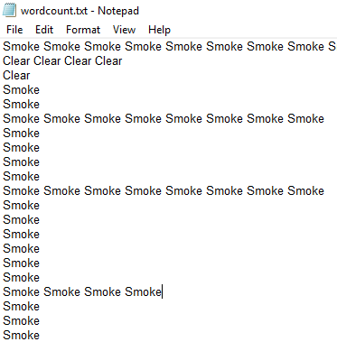
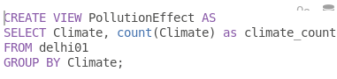
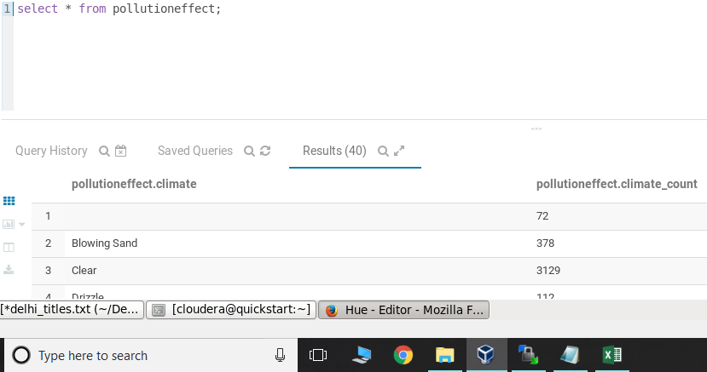
USE OF WORDCOUNT
HIVE QUERY:
Wordcount file contains the unstructured data of column (climate) from table Delhi

Slide 19
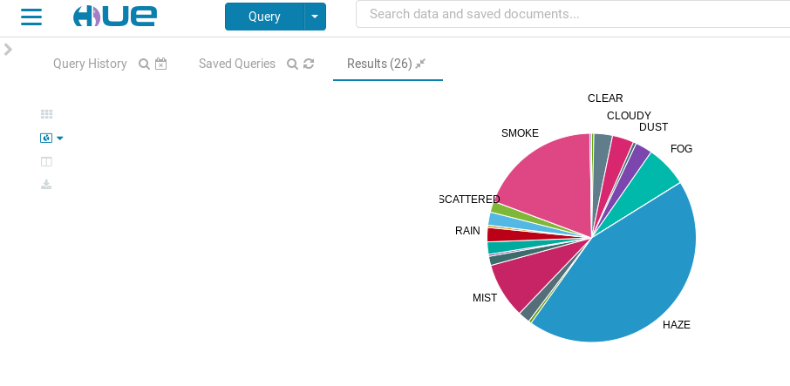
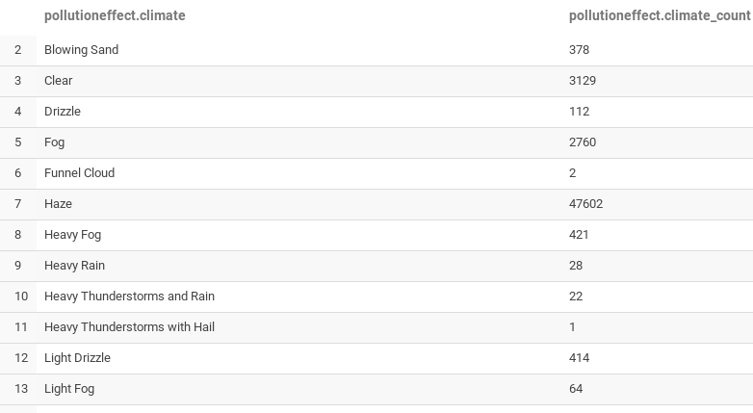
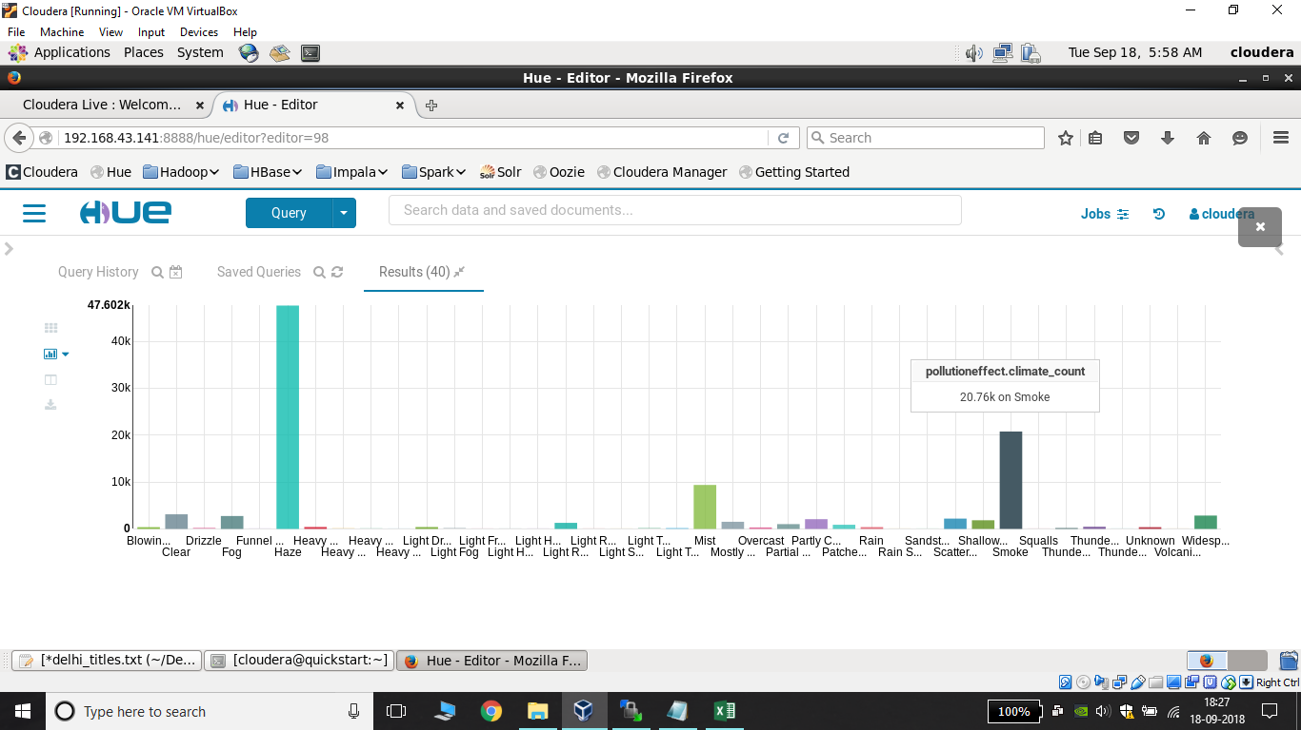
Analysis Of Climate Wordcount
HIGHEST WORDCOUNT OF HAZE

Slide 20
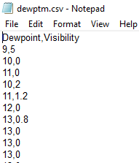
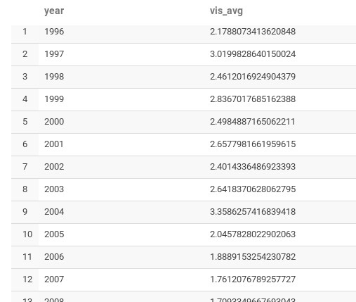
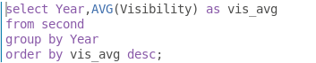
FINDING VISIBILITY AVERAGE OF EACH YEAR
Loading another file
RESULT
QUERY

Slide 21
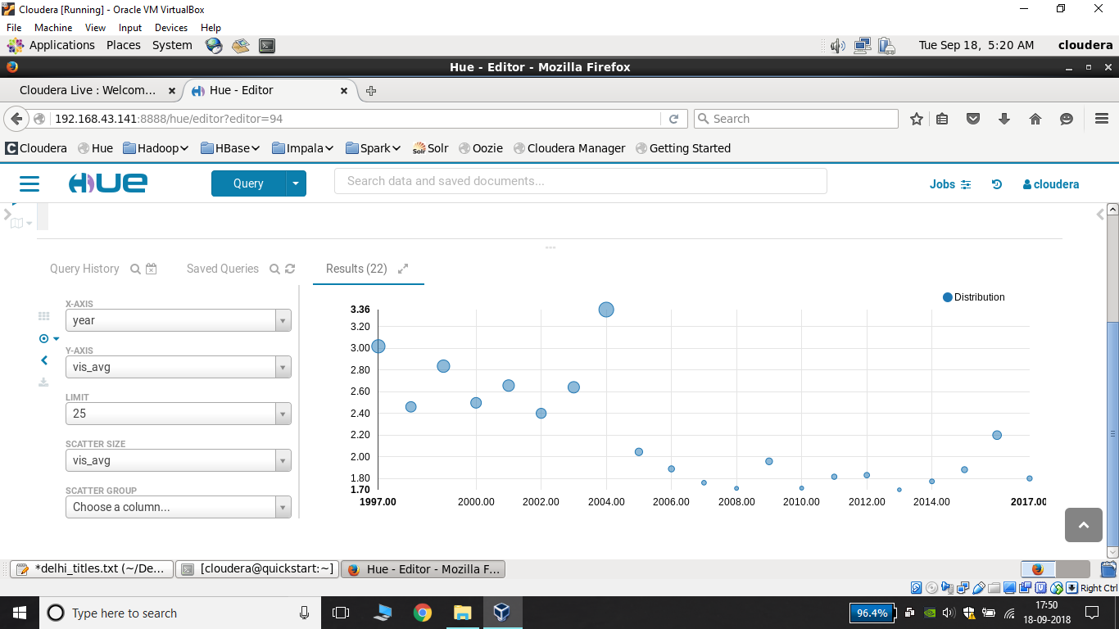
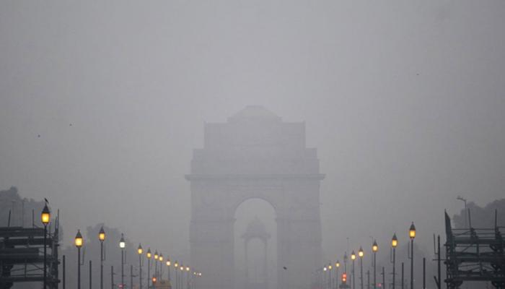

Analysis Of Visibility
The effect of decreasing visibility in the capital city is getting worse day by day.
Estimation of decrease in visibility due to air containments of vehicle emissions within past years.

